Slide 1

G2M Insight for Cab Investment
<19/03/2024>

Slide 2

Agenda
Executive Summary
Problem Statement
Approach
EDA
Recommendations

Slide 3
Problem Statement
Background: XYZ is a private firm in the US. Due to remarkable growth in the Cab Industry in the last few years and multiple key players in the market, it is planning for an investment in the Cab industry and as per their Go-to-Market(G2M) strategy they want to understand the market before taking the final decision.
Objective: Perform exploratory data analysis on the provided datasets to provide actionable insights to XYZ for informed decision-making

Slide 4
Approach
Process Datasets
Create Master Data
Perform EDA
Fit Model
Provide Recommendations
Presence of null/missing values
Incorrect data types
Replace values
Addition of new columns
Identify primary keys to join datasets
Perform EDA on master data
Fit linear regression model to predict profit
Provide strategic recommendations for investment

Slide 5

Data Exploration
Cab_Data.csv
Transaction_ID.csv
Customer_ID.csv
City.csv
Cab_Master_Data.csv
Total # of features: 17 features
Time frame: 02/01/2016 to 31/12/2018
Total # of records: 359,392
Assumptions:
Profit = Price_Charged – Cost_of_Trip
Outliers in Profit are ignored to avoid loss of data prior to further investigation
KM_Travelled and Cost_of_Trip dropped from regression analysis to avoid multicollinearity since they are highly correlated to Profit

Slide 6
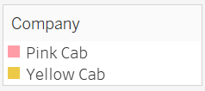
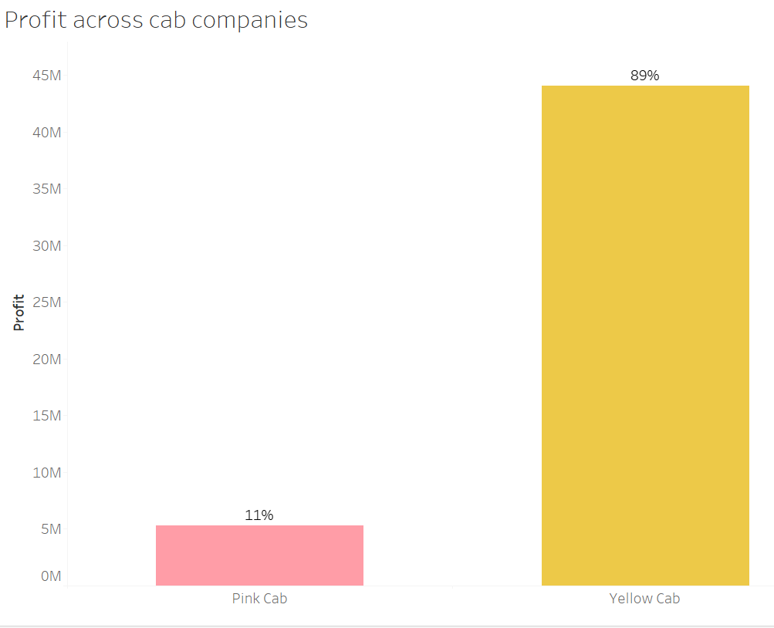
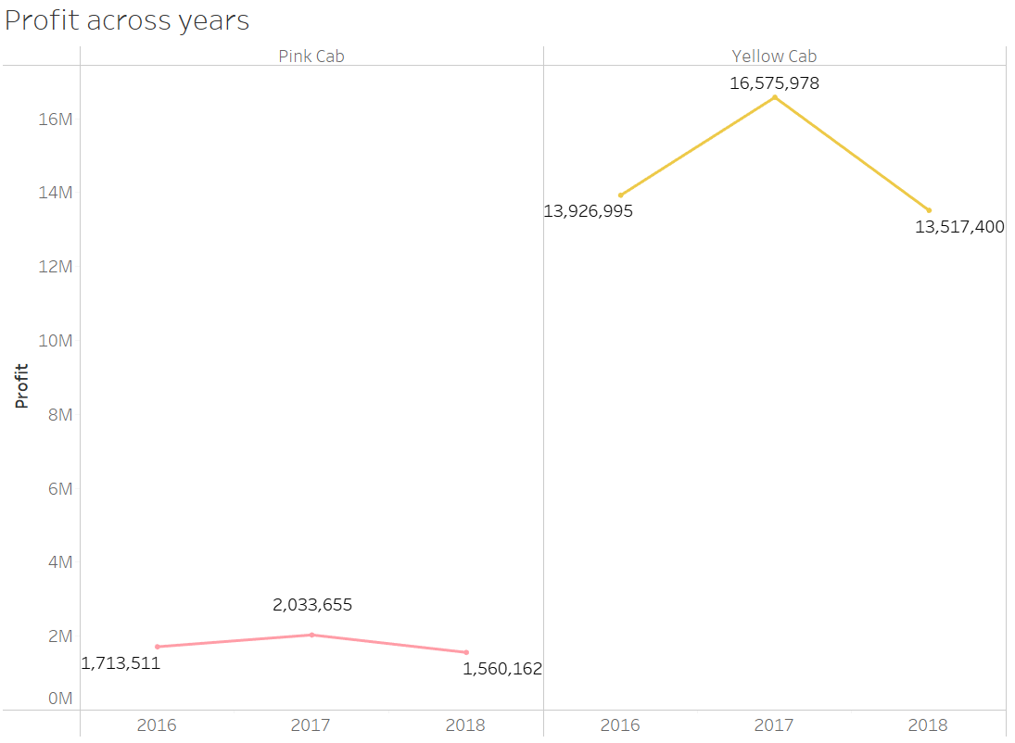
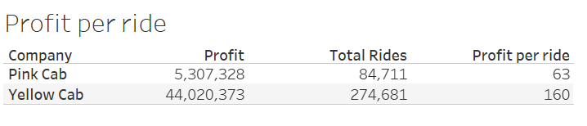
Profit Analysis across companies and years
Yellow cab company has higher profits than pink cab company across years

Slide 7
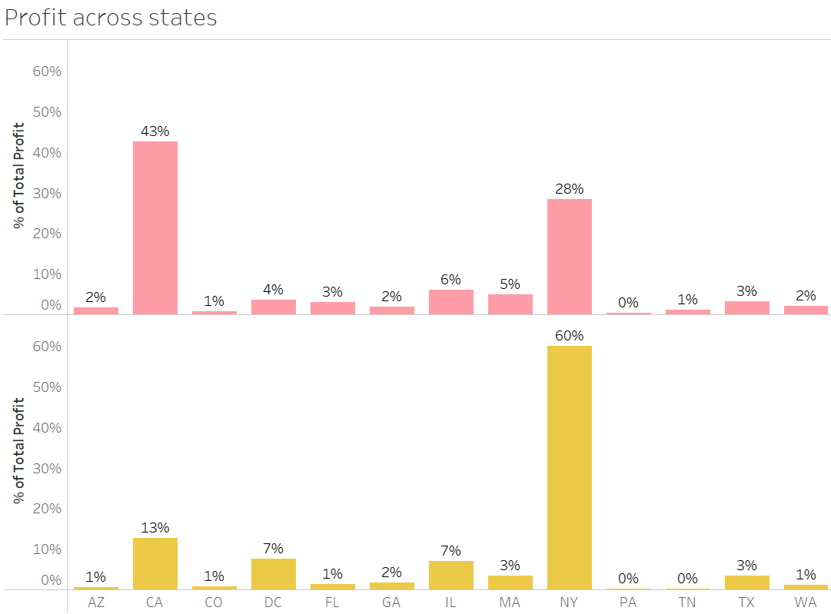
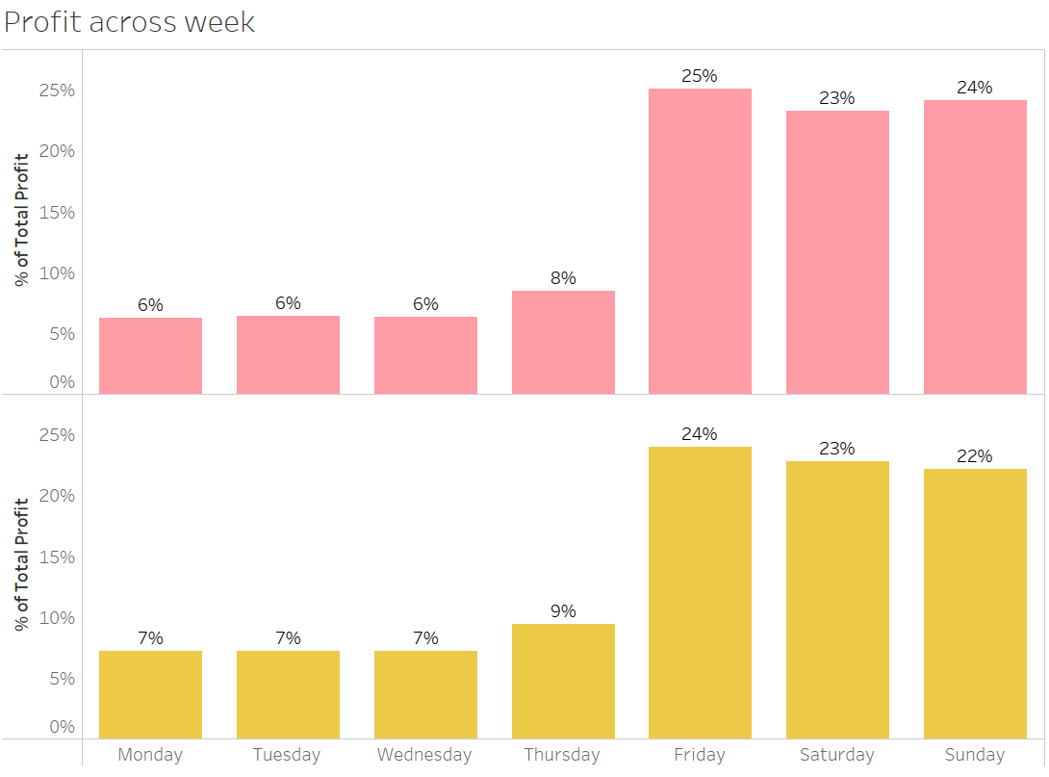
Profit Analysis across states and week
Companies earn the most profit on Fridays and weekends. California and New York are the most profitable states

Slide 8
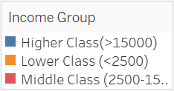
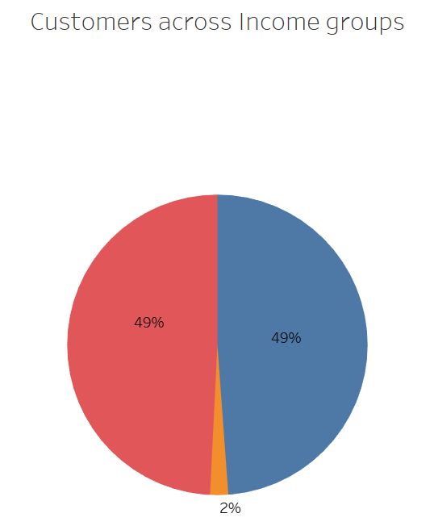
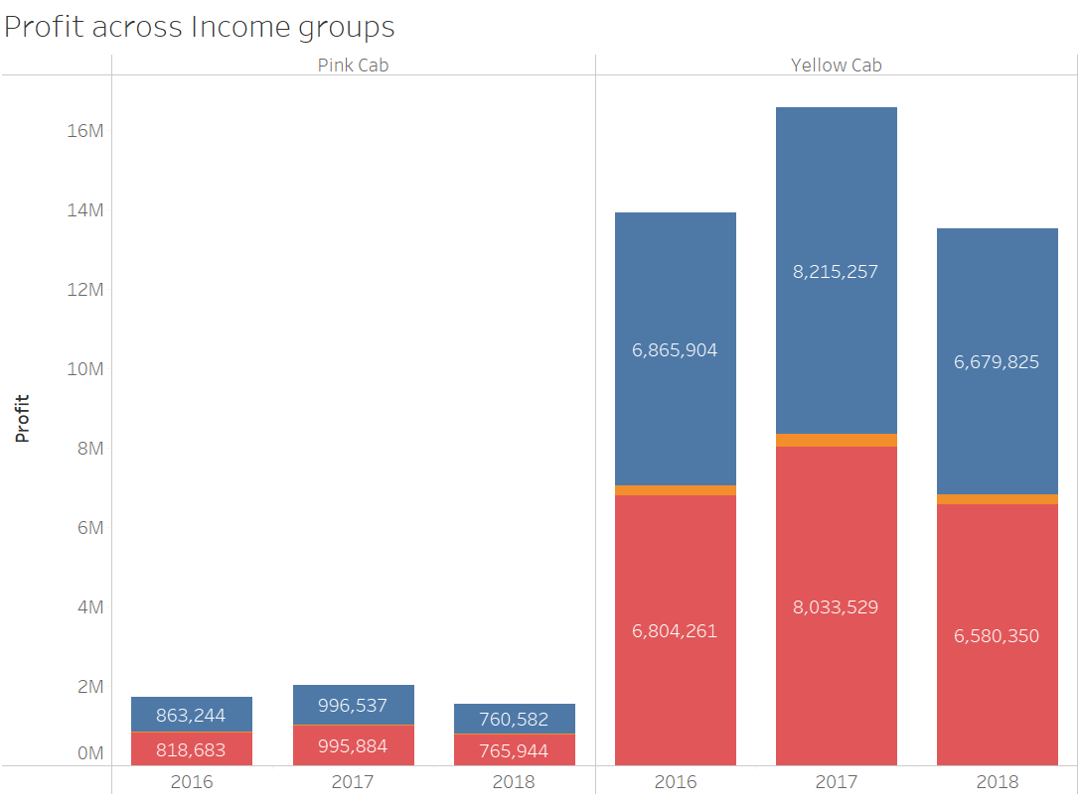
Profit Analysis across income groups
Customers belonging to higher and middle class income groups contribute towards the maximum profits

Slide 9
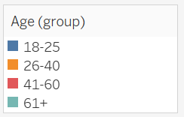
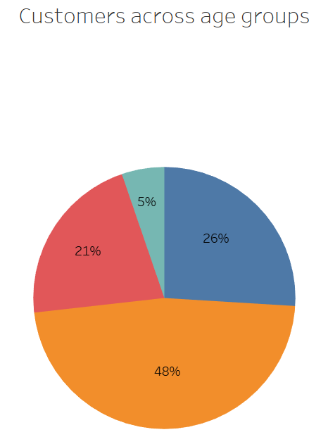
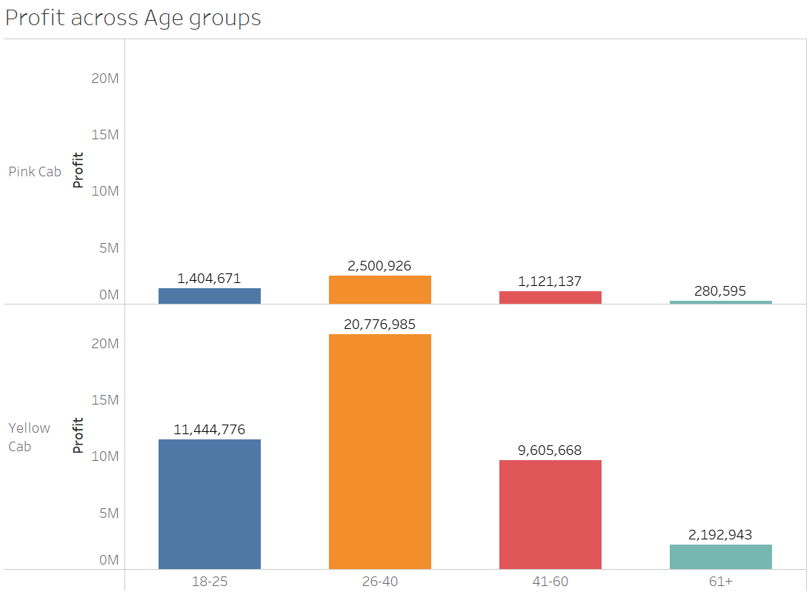
Profit Analysis across age groups
Age groups 26-30 followed by 18-25 contribute the most to the profits of the company

Slide 10
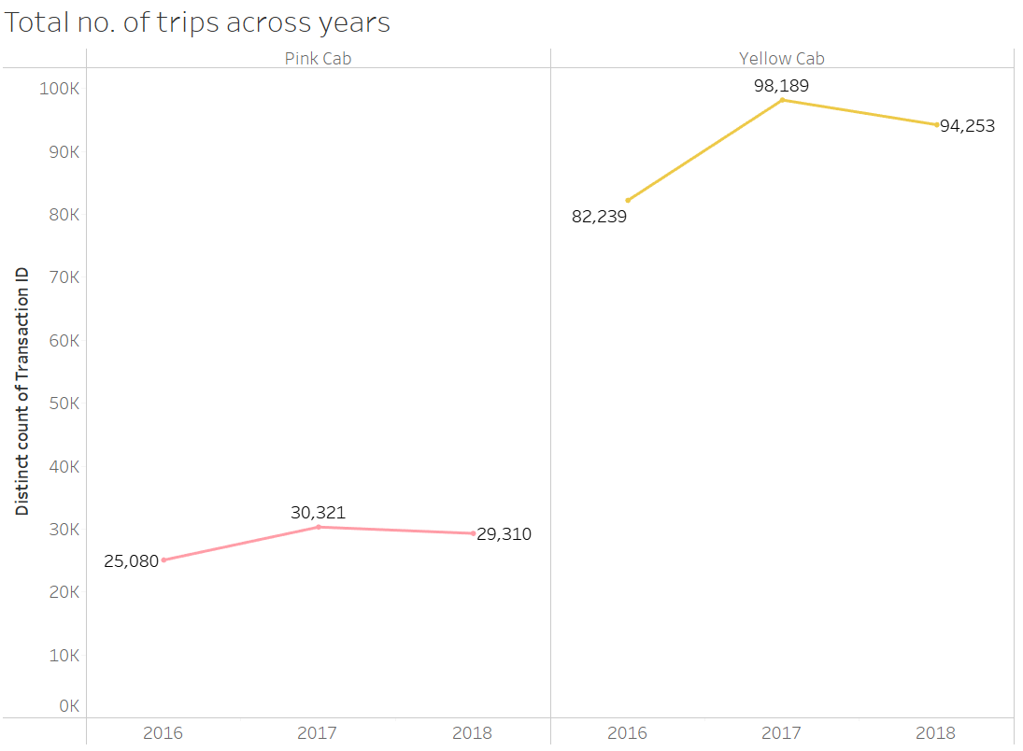
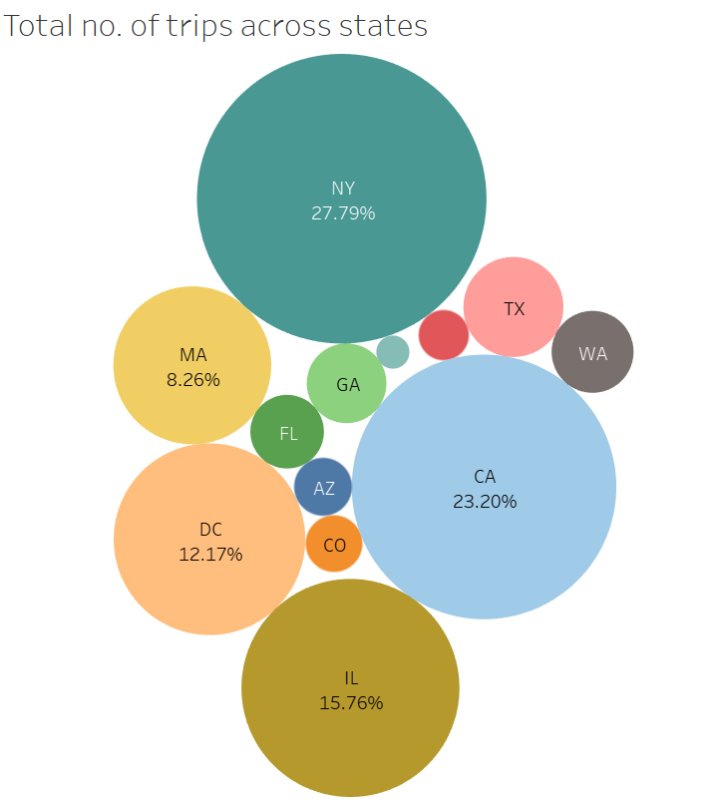
Total number of trips across companies, years, and states
Yellow cab has most number of trips majorly across California, New York, and Illinois

Slide 11
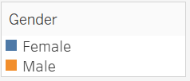
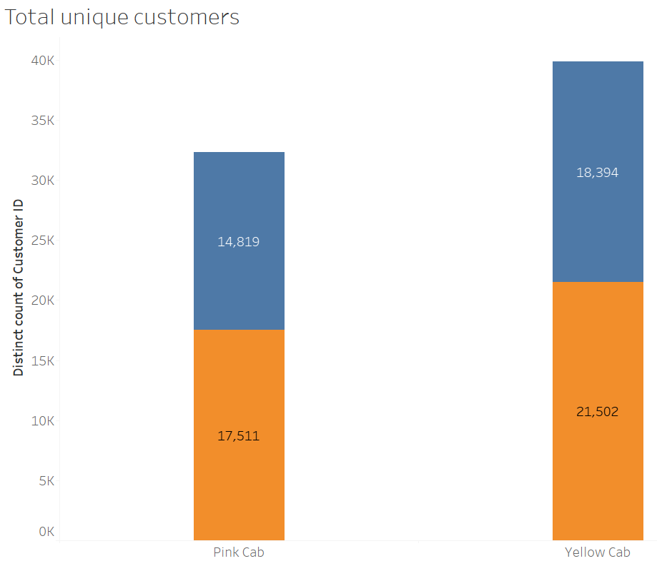
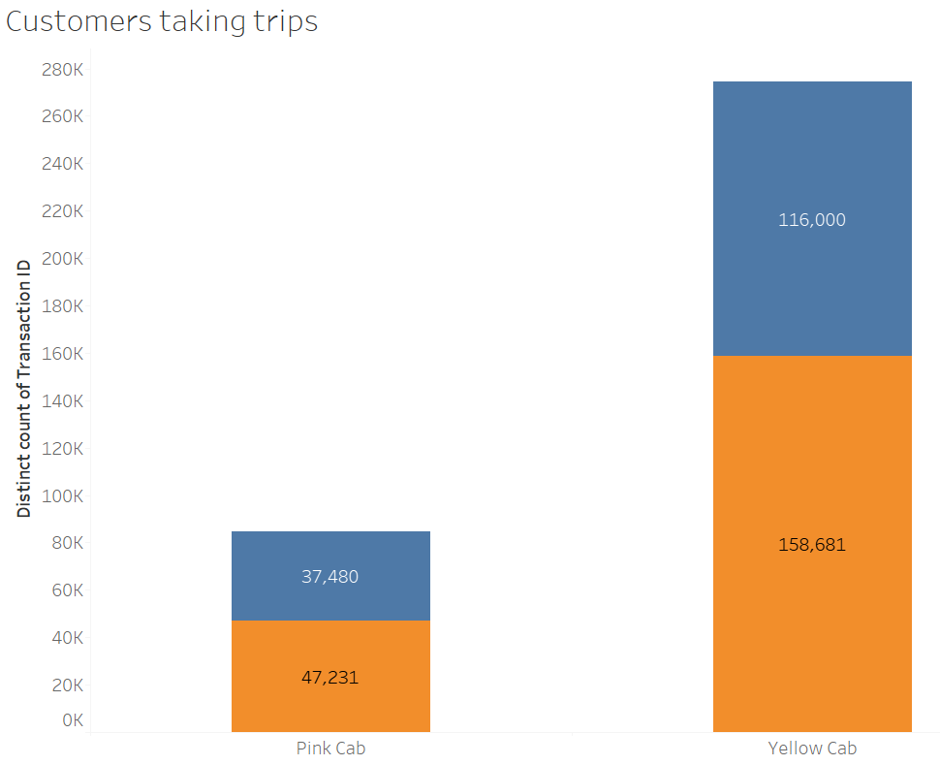
Customer Attributes
Males account for major proportion of the customer base and take higher number of trips than females

Slide 12
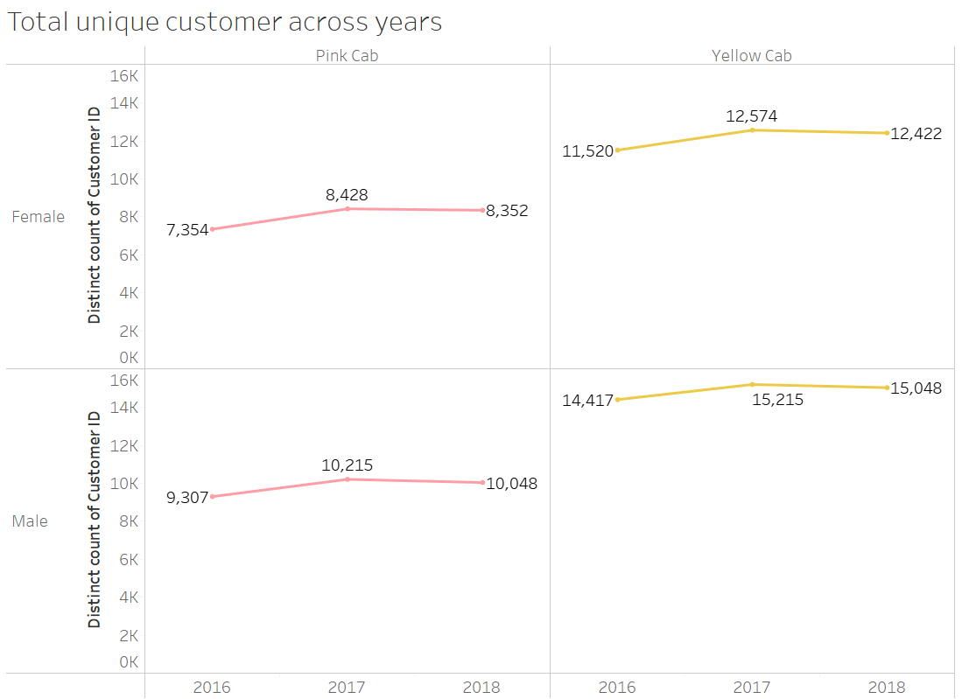
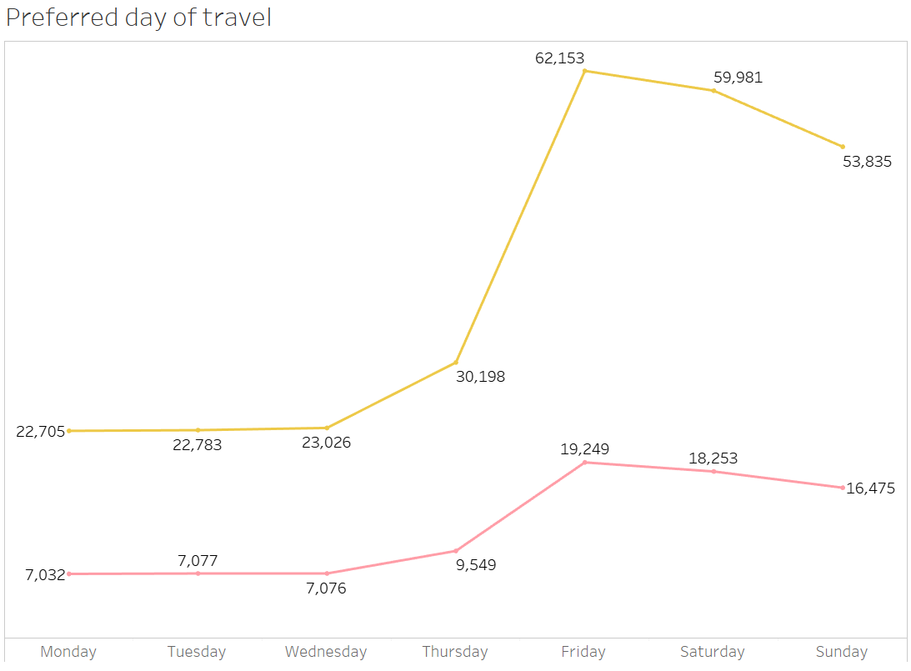
Customer Attributes
Throughout the years, males account for the maximum number of trips. Friday and weekends are preferred for travel.

Slide 13
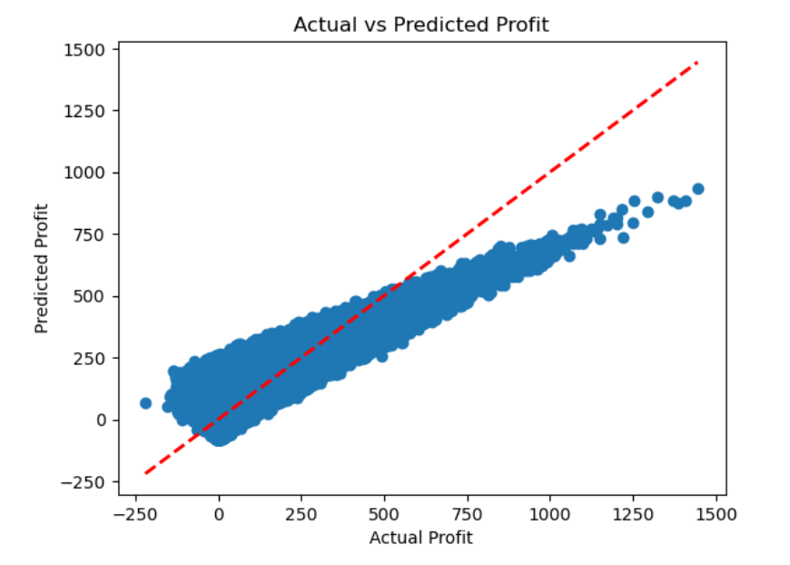
Linear Regression Model results to predict Profits
Profit = 0.496 * Price Charged – 0.0294 * Age + 0.00007 * Income (USD/Month) – 12.157 * Company_Pink Cab + 12.157 * Company_Yellow Cab – 1.397 * Gender_Female + 1.397 * Gender_Male
Model Accuracy = 75.18%

Slide 14
Recommendations
Based on the Exploratory Data Analysis, Yellow cab company seems more suitable for investment
Direct investment towards expanding Yellow cab services, leveraging its consistent profitability and significantly higher profit per ride compared to Pink cab.
Allocate resources to enhance Yellow Cab’s presence and operations in regions where it has the highest number of trips, such as California, New York, and Illinois.
Develop targeted marketing campaigns highlighting Yellow Cab’s profitability and superiority, aiming to attract more customers and increase market share.
Focus on promoting Yellow cab services during peak profit days, particularly Fridays and weekends, to maximize returns on investment.
Implement initiatives to appeal to higher and middle-class income groups, who contribute the most to Yellow Cab’s profits, ensuring efficient utilization of resources.

Slide 15
Thank You

